Slide 1
Credit Card Fraud Detection
Feng Zhao
September 26th, 2022

Slide 2

Overview
1. Exploratory Data Analysis
2. Feature Engineering
3. Resampling Data
4. Model Building and Evaluation
5. Summary

Slide 3
Exploratory Data Analysis (EDA)
Credit card
fraud detection
Feng Zhao

Slide 4
Exploratory Data Analysis
Methodology
1. Start with quality check: missing cells, duplicated rows, unique IDs
2. Continuous/numeric variables: check the distribution on their own and by label (fraud or not)
3. Categorical variables: check their relationships with the label and with other important categorical variables using crosstab function
4. Iterative process
1st round: have a good understanding of data
2nd round: conducted after feature engineering
3rd round and more: facilitate feature selection; identify potential new features

Slide 5
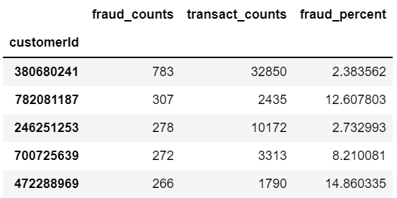
Exploratory Data Analysis
Main Findings
1. The dataset has 786,363 rows and 29 columns.
2. Columns 'accountNumber' and 'customerId' are identical. Six columns are blank.
3. The data is highly imbalanced, with less than 2% of cases in the minority class (98.42% vs. 1.58%).
4. The observation are not independent from each other. There are only 5,000 unique customers/accounts in the dataset. Among them, 2,075 customers have at least one transactions marked as fraud.

Slide 6
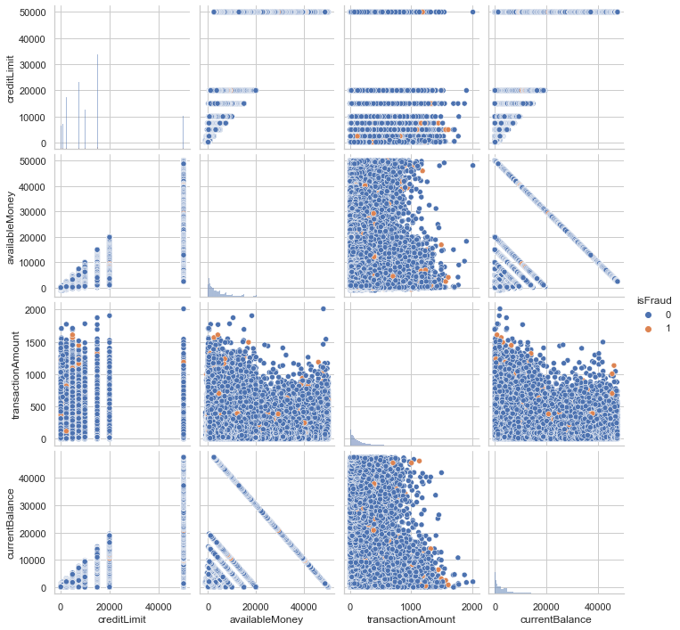
Example plots

Slide 7
Exploratory Data Analysis
Hypothesis
Cases with following characteristics are at higher risk of fraud
Online purchases (online gifts and retail)
Purchases with card not presented
PIN entry via electronic commerce
Rideshare
Higher than average transaction amount
Smaller gaps between transactions
Higher transaction counts
Cases with following characteristics are less risky of fraud
Fast food purchases
integrated circuit card read

Slide 8
Feature Engineering
Credit card
fraud detection
Feng Zhao

Slide 9
Feature Engineering
Below are generated features in the initial model
Generated Features | Meaning
cvv_matched | whether cvv was matched
days_since_accnt_open | days between account open and current transaction date
days_since_address_change | days between last address change and current transaction date
transact_gap_hours | hours between each transactions
money2credit_limit | the ratio between available money and credit limit
transact_avg | average transaction amount at the time of current transaction
transact_order | the number of transactions in the data at the time of current transaction
fraud_counts_at_transaction | the number of fraud transactions in the data at the time of current transaction
transact_amount_diff | the difference between current transaction amount and average transaction amount
transact_cl_ratio | the ratio between transaction amount and credit limit

Slide 10
Feature Engineering
Why did I do the feature engineering for training and testing data sets at the same time?
1. The dataset does not consist of independent observations. The majority customers have multiple transactions in the data. The information has already ‘leaked’ to the model.
2. If I did the feature for the testing dataset separately, I would not be able to access the full information about the customer/account such as:
How many transactions the customer has made?
How often the customer make a transaction?
When was the last transaction for the customer?
How many transactions have been marked as fraud previously and when?

Slide 11
Resampling Data
Credit card
fraud detection
Feng Zhao

Slide 12
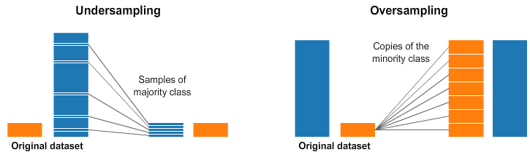
Resampling
I randomly down sampled
non-fraud cases, varying the
ratio between fraud cases and
Non-fraud cases from 0.1 to 0.9.
Why did I also do random undersampling on the testing set?
The observations are highly correlated
It’s ideal for the testing set more like the training set
What should we do in industry?
Let’s discuss……
(my initial thought is to randomly oversample fraud cases when doing real time fraud detection)
I then oversampled fraud
cases using the SMOTE* approach
on the basis of the undersampled
data.
I did so either only on training
data or on both the training and
testing data set.
SMOTE: Synthetic Minority Oversampling Technique

Slide 13
Model Building & Evaluation
Credit card
fraud detection
Feng Zhao

Slide 14
1. Model Building and Evaluation
Discussion on model choices
Why did I choose XGBoost?
Metrics of model without resampling and hyperparameter tuning
Metrics of XGBoost model after hyperparameter tuning and model after feature selection
 | Precision | Recall | F1 Score | Accuracy
XGBoost (default parameter) | 0.546 | 0.014 | 0.028 | 0.984
K Nearest Neighbors (k = 5) | 0.097 | 0.002 | 0.005 | 0.984
 | Precision | Recall | F1 Score | Accuracy
Model after hyperparameter tuning (57 features) | 0.767 | 0.826 | 0.795 | 0.799
Model after feature selection (28 features) | 0.770 | 0.824 | 0.796 | 0.800

Slide 15
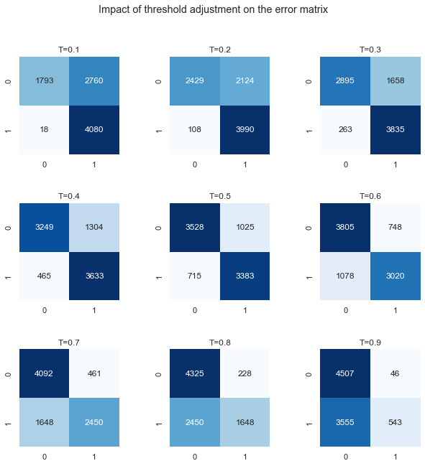
Thresholds and Confusion Matrix
Precision-Recall Trade off:
Threshold 0.1
Recall: 0.996 Precision:0.596
Threshold 0.2
Recall: 0.974 Precision:0.653
Threshold 0.3
Recall: 0.934 Precision:0.700
Threshold 0.4
Recall: 0.887 Precision:0.736

Slide 16
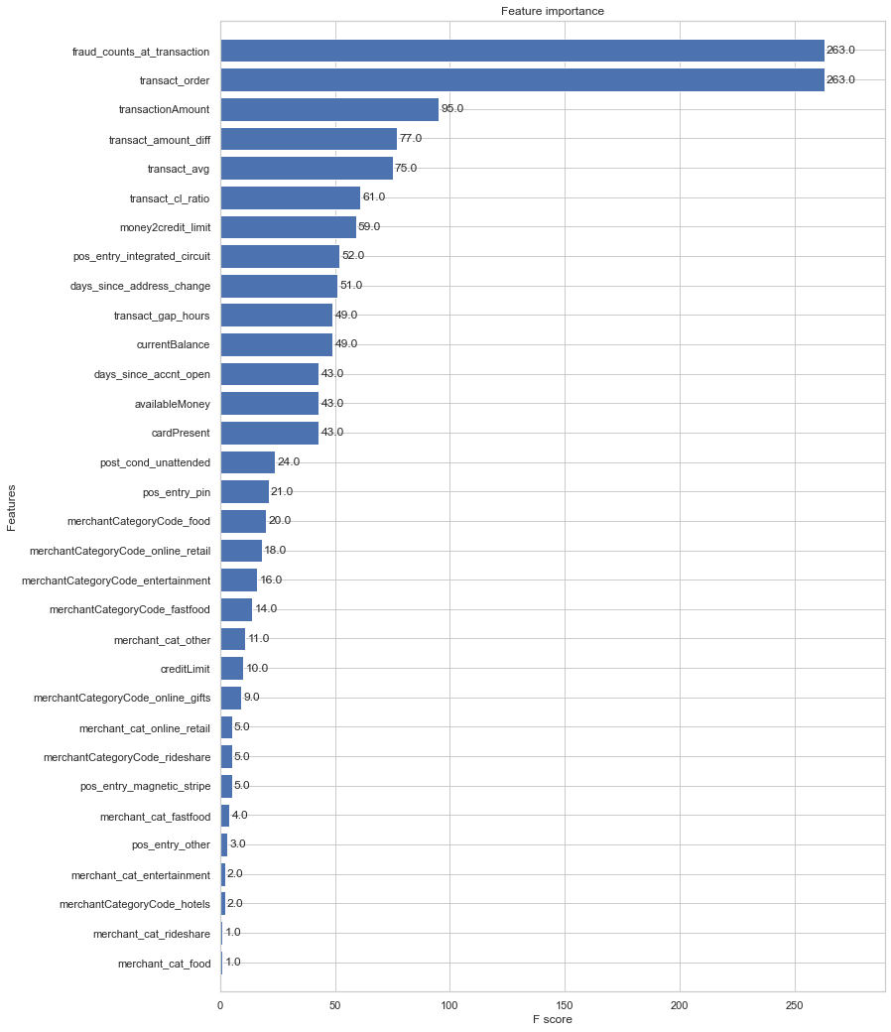
Feature Importance
Top driver of credit card fraud

Slide 17
Summary
Credit card
fraud detection
Feng Zhao

Slide 18
Summary
1. The project is challenging: 1) high imbalanced data and 2) interrelated observations
2. All models I experimented did not work well on this data before random undersampling
3. After the undersampling was done, the performance of XGBoost improved significantly
4. The model can be further improved upon further hyperparameter tuning and feature selection
5. Threshold moving might play a critical role in case of building predictive models with imbalanced data.

Slide 19
Summary
How to further improve the predictive model?
1. Generate more features: e.g., create interaction variables among important categorical and numerical variables
2. More finetuned feature selection (e.g., RFE) and Hyperparameter Tuning
3. Try other models such as DNN and DCN.
4. Access to additional features such as demographic variables, credit score, and geo info.
5. Learn from domain knowledge experts
6. Learn from recommendation system.
Within customers
Between customer

Slide 20
Thank you!
Credit card
fraud detection
Feng Zhao

